Slide 1
Connecticut Part C State Performance Plan Indicator 11 State Systemic Improvement Plan
Phase II

Slide 2
Connecticut Part C State Performance Plan Indicator 11 State Systemic Improvement Plan
Phase II

Slide 3
SPP/APR - C11 - SSIP /ehs • sip/
Phase II

Slide 4
FY
SPP/APR
Submitted in FY
C11-SSIP
13-14
Year 1
Phase I - Analysis
14-15
Year 2
14-15
Phase II - Plan
15-16
Year 3
15-16
Phase III - Evaluate
16-17
Year 4
16-17
17-18
Year 5
17-18
18-19
Year 6
18-19
19-20

Slide 5
Phase I
submitted April 1, 2015
-2-
Infrastructure Analysis
-4-
State-identified Measurable Result (SiMR)
-1-
Data Analysis
-3-
Coherent Improvement Strategies
-5-
Theory of Action Graphic

Slide 6
Phase II
due April 1, 2016
-1-
Infrastructure
Development
-2-
Support to
EIS Programs
-3-
Evaluation

Slide 7
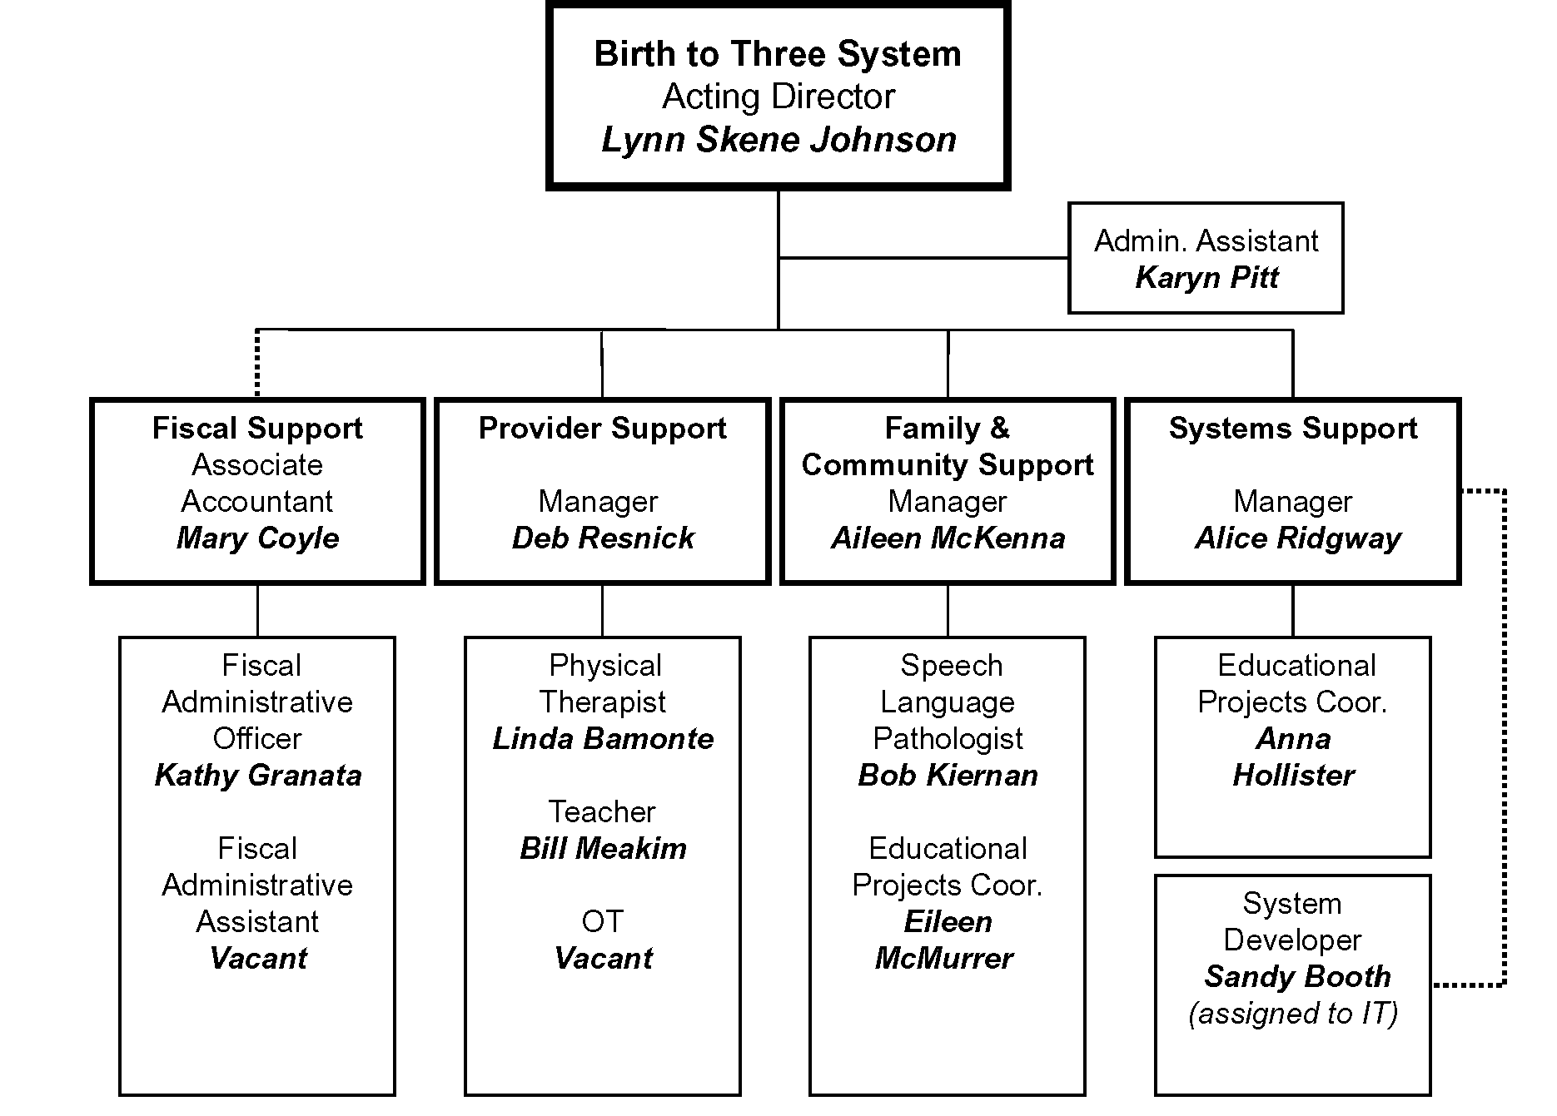

Slide 8
Phase II
due April 1, 2016
-1-
Infrastructure
Development
-2-
Support to
EIS Programs
-3-
Evaluation
Fiscal and Systems Support Teams
Provider Support Team
Family and Community Support Team

Slide 9
SiMR
Parents of children who have a diagnosed condition will be able to describe their child’s abilities and challenges more effectively as a result of their participation in Early Intervention.

Slide 10
CT Part C SSIP Theory of Action
If
then
Then
….parents, health care providers, and EIS providers all have a shared understanding about the true purpose of early intervention visits to coach families, and
….providers will implement research supported practices with fidelity including natural learning environment practices, coaching as a style of interaction with families, and the use of a primary service provider approach
and
…families will learn new skills and understand the unique ways that they can help their children develop and learn.
…families will be better able to describe their child’s abilities and challenges
so that
their children receive individualized services in natural settings and demonstrate improved behavioral and educational results.
Knowledge of Evidence Base by parents, health care providers, and EIS providers
….all training and TA is aligned to support families as decision makers (vs. only providing therapy services to children), and
Training for parents, health care providers, and EIS providers
Policy as reflected in procedures, forms, and service guidelines
….the lead agency and EIS programs revise policies, procedures, and guidelines to focus on supporting families,
“My son learns best by watching, parallel play, and hand over hand when he doesn't know how to move his body.”
“My son’s language is great, but he often needs reminders to take a breath before he speaks so he can be heard.”

Slide 11
….parents, health care providers, and EIS providers all have a shared understanding about the true purpose of early intervention visits to coach families, and
Knowledge of Evidence Base
….all training and TA is aligned to support families as decision makers (vs. only providing therapy services to children), and
Training
Policy procedures, forms, and service guidelines
….the lead agency and EIS programs revise policies, procedures, and guidelines to focus on supporting families,

Slide 12
Improvement Strategy: Marketing Plan
System Components* | The State needs to… | Health Care Providers need to… | Families will…
* Governance, Fiscal, Quality Standards, Professional Development, Data, TA, A&M

Slide 13
Improvement Strategy: Marketing Plan
System Components* | The State needs to… | CDI needs to… | Families will…
* Governance, Fiscal, Quality Standards, Professional Development, Data, TA, A&M

Slide 14
Improvement Strategy: Marketing Plan
System Components* | The State needs to… | Program Directors need to… | Home Visitors need to… | Families will…
* Governance, Fiscal, Quality Standards, Professional Development, Data, TA, A&M

Slide 15
What actions are needed at each level to achieve the SiMR?
How are those actions specifically aligned with the system components, strengths, areas for improvement, and current state-level improvement plans or initiatives?
What does success look like?
How will you know when you’ve accomplished this?
How is it measured?

Slide 16
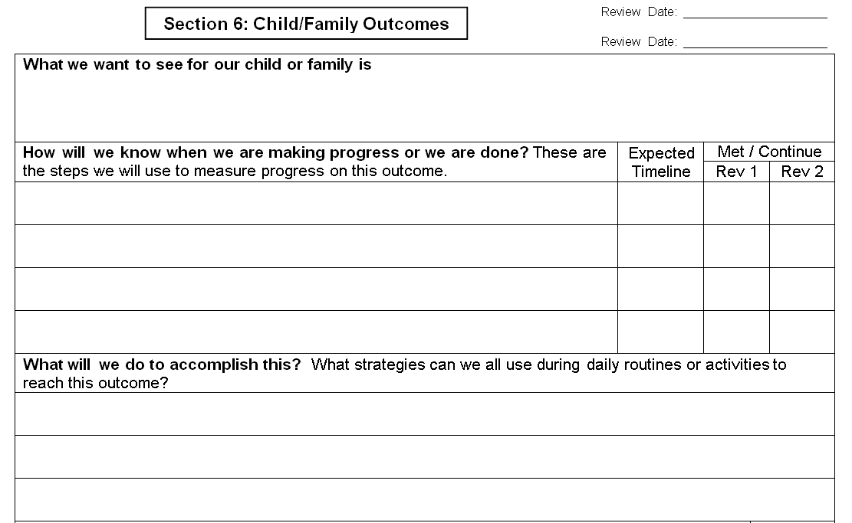

Slide 17
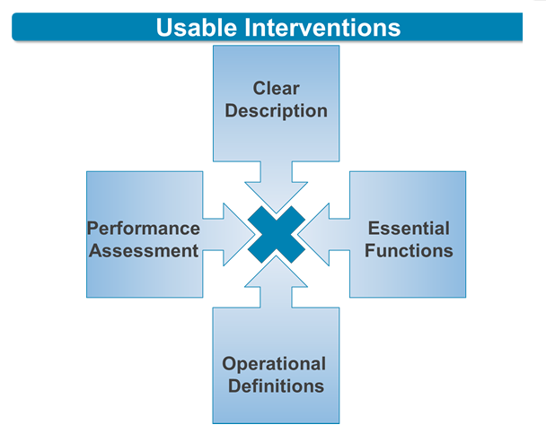
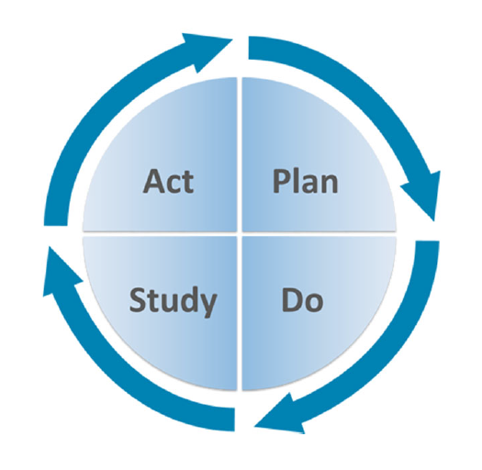
Active Implementation Hub
http://implementation.fpg.unc.edu/
The AI Hub is developed and maintained by the State Implementation and Scaling-up of Evidence-based Practices Center (SISEP) and the National Implementation Research Network (NIRN) at The University of North Carolina at Chapel Hill's FPG Child Development Institute. Content is added and updated regularly. For more information, contact sisep@unc.edu

Slide 18
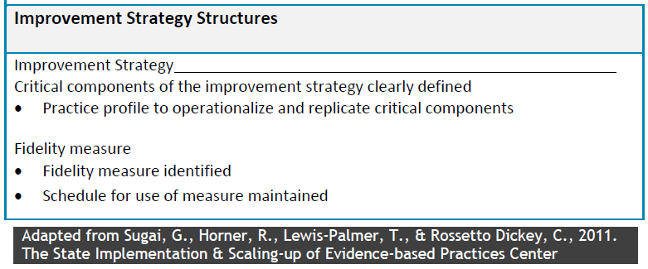
Practice Profile Planning

Slide 19
Practice Profile Planning

Slide 20
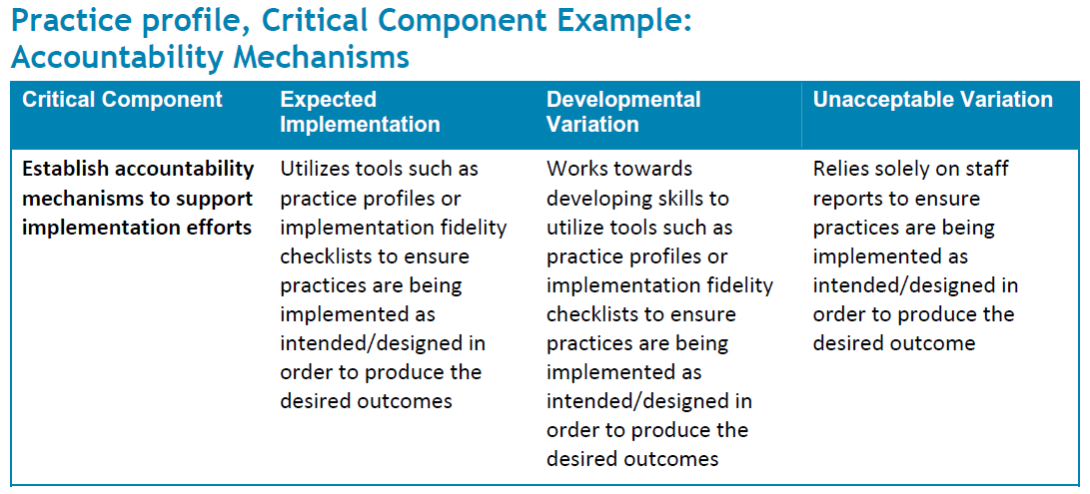
Example

Slide 21
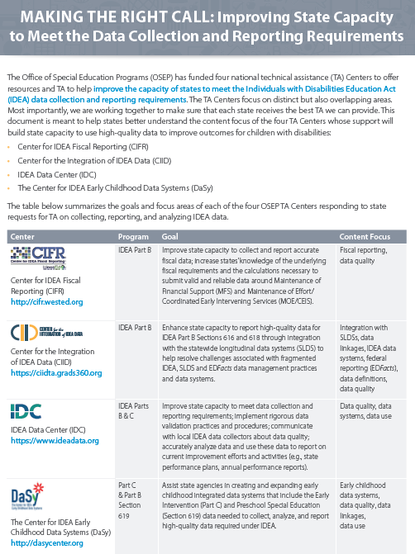
OSEP Funded TA Centers
NCSI
ECTA
IDC
DaSy

Slide 22
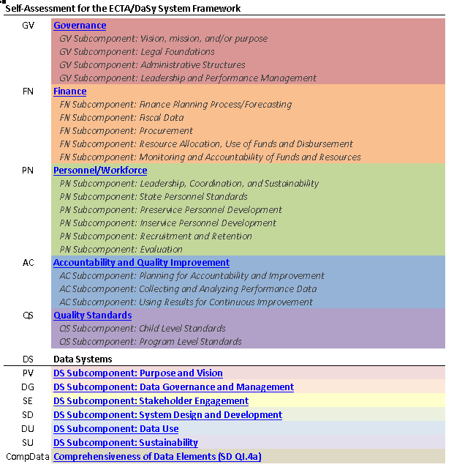
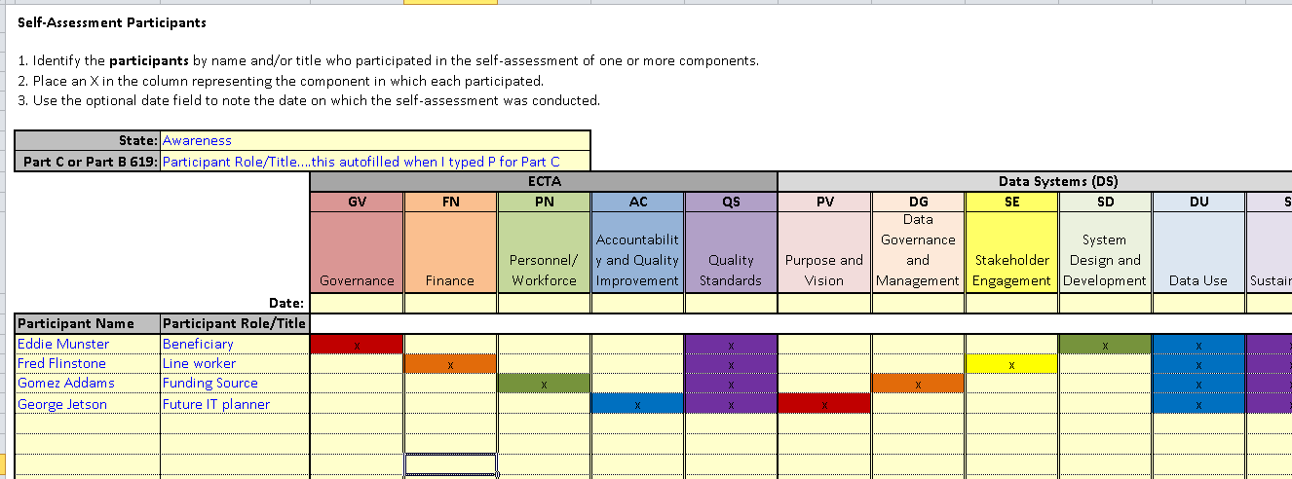
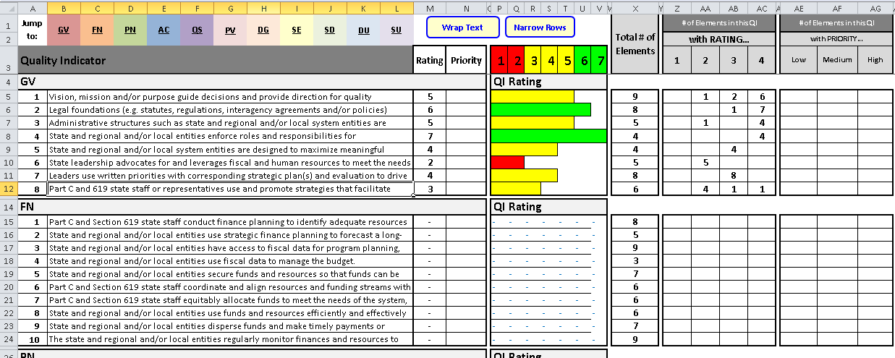
ECTA / DaSy Self Assessment

Slide 23
Connecticut Part C Administration Priorities
New Payment System (Medicaid Changes)
Marketing Birth to Three (More Family Support)
Efficient Internal Processes / Evaluation
Inclusion in the OEC

Slide 24
Connecticut State ICC Priorities
Quality
Legislative / Fiscal
Communication and Education

Slide 25
Similar Priorities
New Payment System ~ Legislative / Fiscal
Rebranding B23 ~ Communication / Education
Efficient Processes ~ Quality

Slide 26
Chuck or Chunk
Initial Brainstorming of Coherent Improvement Strategies:
Knowledge: Parents, Healthcare Providers, EIS Program Staff
1. Educate parents about their role in Connecticut’s Birth to Three model of service delivery and the goal of increasing their confidence and competence in being able to describe their child’s abilities and challenges as well as their role during transition and at PPT meetings.
2. Revise the Family Handbooks so that they correctly describe what early intervention is while making them more accessible to a generation of parents that text message and read on smartphones.
3. Promote the sharing of online family stories to highlight the benefits of families being able to describe their child’s abilities and challenges.
4. Develop a marketing plan to educate health care providers about how the Birth to Three system uses research supported practices such as natural environment practices including coaching interactions with parents and efforts to empower parents along with highly quality therapeutic strategies.
5. Develop a marketing plan for EIS providers so they understand the importance of enhancing the family’s ability to meet their child’s needs, as well as increasing the family’s confidence and competence in describing their child’s abilities and challenges.
Training: Parents, EIS Program Staff, Healthcare Providers
1. Intensive training and technical assistance (TA) for an initial cohort of nine programs on implementing with fidelity research supported practices (RSPs) including natural learning environment practices, coaching as a style of interaction with families, and the use of a primary service provider approach to teaming. Begin with the earliest contacts, and move through the evaluation and assessment process, writing functional outcomes on IFSPs and jointly developing strategies for learning opportunities within the family’s routines, and to transition planning.
2. Work with the UCEDD at UCONN to assist with implementation and evaluation following the training led by Rush and Shelden: operationalize the training objectives into measureable outcomes for changes in practice.
3. Support a Community of Practice (CoP) for EIS program leaders in the initial cohort about the implementation of RSPs.
4. Scale up the implementation of the RSPs with the remaining programs.
5. Create online training modules for parents to highlight the benefits of being able to describe their child’s abilities and challenges as well as helpful techniques.
6. Continue providing targeted TA about the writing of functional outcomes and objectives with families as well as other topics identified through the general supervision of programs.
7. Provide supervisor training for EIS programs about how to support staff implementing RSPs and to increase knowledge of practices that support achievement of SiMR.
8. Encourage each EIS program to have at least one infant mental health endorsed professional on staff.
9. Offer more opportunities for developing skills to evaluate social and emotional development including the Devereux Early Childhood Assessment for Infants and Toddlers (DECA-I/T) training.
10. Offer training over the course of the year in a plan-full way that maximizes staff availability and reduce costs to programs.
Policy: Procedures, Forms, and Data
1. Complete the DaSy Center and ECTA Center Framework self-assessments.
2. Meet regularly with the 1st cohort of programs Community of Practice to review policies, procedures and forms as well as system issues such a billing and the system of payments policy to remove barriers when possible and streamline processes to make providing RSPs efficient and cost effective.
3. Revise Connecticut’s statewide Individualized Family Service Plan (IFSP) form with prompts to encourage more input from parents in describing their child and formulating outcomes. Revise the Outcome page as needed to facilitate improved outcomes, objectives and strategies.
4. Revise Connecticut’s Birth to Three Natural Environments Service Guideline to include working in early care and education settings, supporting the family’s ability to communicate about their child using common language from the Connecticut Early Learning and Development Standards (CT ELDS) described in the Infrastructure Analysis and SiMR sections.
5. Develop Evaluation/Assessment and Report Writing Guidelines and training to assist families with describing their child’s abilities and challenges from their first contacts with the system while making it clear that they have a pivotal role as decision-maker and participant in implementing identified strategies.
6. Enhance EIS providers use of ongoing assessment curricula results with parents in order to inform them about the next steps in development and facilitate a greater understanding by parents about their child’s abilities and challenges.
7. Assist the Office of Early Childhood with development of an assessment tool for the CT ELDS and continue to work on improving the relevancy of the CT ELDS as a tool for EIS providers.
8. Consider development of a rating tool to measure how parents describe their child’s abilities and challenges with UCONN’s UCEDD as part of item II #3 above.
9. Update and modify the self-assessment that EIS programs complete to emphasize how RSPs are being implemented and documented.
10. Better align the priority area, rankings and visit protocol for Focused Monitoring with the SiMR.
11. Enhance the Part C data system to collect ongoing indicators of how the RSPs are being implemented and assure that the ECIS includes critical indicators related to the SiMR for Part C.
12. Improve data sharing and connections with the State Department of Education using an existing common unique identifier to link Part C records to Kindergarten and 3rd grade assessment data as a way to measure long term student educational results since in Connecticut families are only enrolled in Part C for an average of 11 months.
13. Expand user access to the SPIDER data system to allow EIS providers to view and enter information from mobile devices in families’ homes.
14. Partner with the Early Childhood Integrated Data System (ECIDS) being developed to allow for longitudinal evaluation of the effectiveness of Early Intervention and this SSIP.
15. Simplify the Payment procedure and revise contracts as needed to support the provision of RSPs such as coaching in natural learning setting with primary services providers and joint visits.
16. Modify how Medicaid revenue is maximized as required by the state without disrupting services to families and while assuring that the RSPs are main drivers.
17. Continue to evaluate the impact of the Family Cost Participation system on families choosing to enroll in Birth to Three as related to assuring that the state can achieve results for all eligible families with infants and toddlers with delays and disabilities.
18. Facilitate a smooth transition to the Office of Early Childhood.

Slide 27
Knowledge: Parents, Healthcare Providers, EIS Program Staff
1. Educate parents about their role in Connecticut’s Birth to Three model of service delivery and the goal of increasing their confidence and competence in being able to describe their child’s abilities and challenges as well as their role during transition and at PPT meetings.
2. Revise the Family Handbooks so that they correctly describe what early intervention is while making them more accessible to a generation of parents that text message and read on smartphones.
3. Promote the sharing of online family stories to highlight the benefits of families being able to describe their child’s abilities and challenges.
4. Develop a marketing plan to educate health care providers about how the Birth to Three system uses research supported practices such as natural environment practices including coaching interactions with parents and efforts to empower parents along with highly quality therapeutic strategies.
5. Develop a marketing plan for EIS providers so they understand the importance of enhancing the family’s ability to meet their child’s needs, as well as increasing the family’s confidence and competence in describing their child’s abilities and challenges.

Slide 28
Training: Parents, EIS Program Staff, Healthcare Providers
1. Intensive training and technical assistance (TA) for an initial cohort of nine programs on implementing with fidelity research supported practices (RSPs) including natural learning environment practices, coaching as a style of interaction with families, and the use of a primary service provider approach to teaming. Begin with the earliest contacts, and move through the evaluation and assessment process, writing functional outcomes on IFSPs and jointly developing strategies for learning opportunities within the family’s routines, and to transition planning.
2. Work with the UCEDD at UCONN to assist with implementation and evaluation following the training led by Rush and Shelden: operationalize the training objectives into measureable outcomes for changes in practice.
3. Support a Community of Practice (CoP) for EIS program leaders in the initial cohort about the implementation of RSPs.
4. Scale up the implementation of the RSPs with the remaining programs.
5. Create online training modules for parents to highlight the benefits of being able to describe their child’s abilities and challenges as well as helpful techniques.
6. Continue providing targeted TA about the writing of functional outcomes and objectives with families as well as other topics identified through the general supervision of programs.
7. Provide supervisor training for EIS programs about how to support staff implementing RSPs and to increase knowledge of practices that support achievement of SiMR.
8. Encourage each EIS program to have at least one infant mental health endorsed professional on staff.
9. Offer more opportunities for developing skills to evaluate social and emotional development including the Devereux Early Childhood Assessment for Infants and Toddlers (DECA-I/T) training.
10. Offer training over the course of the year in a plan-full way that maximizes staff availability and reduce costs to programs.

Slide 29
Policy: Procedures, Forms, and Data
1. Complete the DaSy Center and ECTA Center Framework self-assessments.
2. Meet regularly with the 1st cohort of programs Community of Practice to review policies, procedures and forms as well as system issues such a billing and the system of payments policy to remove barriers when possible and streamline processes to make providing RSPs efficient and cost effective.
3. Revise Connecticut’s statewide Individualized Family Service Plan (IFSP) form with prompts to encourage more input from parents in describing their child and formulating outcomes. Revise the Outcome page as needed to facilitate improved outcomes, objectives and strategies.
4. Revise Connecticut’s Birth to Three Natural Environments Service Guideline to include working in early care and education settings, supporting the family’s ability to communicate about their child using common language from the Connecticut Early Learning and Development Standards (CT ELDS) described in the Infrastructure Analysis and SiMR sections.
5. Develop Evaluation/Assessment and Report Writing Guidelines and training to assist families with describing their child’s abilities and challenges from their first contacts with the system while making it clear that they have a pivotal role as decision-maker and participant in implementing identified strategies.
6. Enhance EIS providers use of ongoing assessment curricula results with parents in order to inform them about the next steps in development and facilitate a greater understanding by parents about their child’s abilities and challenges.
7. Assist the Office of Early Childhood with development of an assessment tool for the CT ELDS and continue to work on improving the relevancy of the CT ELDS as a tool for EIS providers.
8. Consider development of a rating tool to measure how parents describe their child’s abilities and challenges with UCONN’s UCEDD as part of item II #3 above.
9. Update and modify the self-assessment that EIS programs complete to emphasize how RSPs are being implemented and documented.
10. Better align the priority area, rankings and visit protocol for Focused Monitoring with the SiMR.
11. Enhance the Part C data system to collect ongoing indicators of how the RSPs are being implemented and assure that the ECIS includes critical indicators related to the SiMR for Part C.
12. Improve data sharing and connections with the State Department of Education using an existing common unique identifier to link Part C records to Kindergarten and 3rd grade assessment data as a way to measure long term student educational results since in Connecticut families are only enrolled in Part C for an average of 11 months.
13. Expand user access to the SPIDER data system to allow EIS providers to view and enter information from mobile devices in families’ homes.
14. Partner with the Early Childhood Integrated Data System (ECIDS) being developed to allow for longitudinal evaluation of the effectiveness of Early Intervention and this SSIP.
15. Simplify the Payment procedure and revise contracts as needed to support the provision of RSPs such as coaching in natural learning setting with primary services providers and joint visits.
16. Modify how Medicaid revenue is maximized as required by the state without disrupting services to families and while assuring that the RSPs are main drivers.
17. Continue to evaluate the impact of the Family Cost Participation system on families choosing to enroll in Birth to Three as related to assuring that the state can achieve results for all eligible families with infants and toddlers with delays and disabilities.
18. Facilitate a smooth transition to the Office of Early Childhood.

Slide 30
Next Steps
Component Team Leaders
Other Stakeholders
Timeline
TRULY Final Draft by March 1
Drafts by January 1 (seriously)
Roughed out by October
August Meeting

Slide 31
THANK YOU!

