Slide 1
Connecticut Part C State Performance Plan Indicator 11 State Systemic Improvement Plan
Phase II

Slide 2
SiMR
Parents of children who have a diagnosed condition will be able to describe their child’s abilities and challenges more effectively as a result of their participation in Early Intervention.
Families will be better able to describe their child’s abilities and challenges so that their children receive individualized services in natural settings and demonstrate improved behavioral and education results.

Slide 3
Phase II
due April 1, 2016
-1-
Infrastructure
Development
-2-
Support to
EIS Programs
-3-
Evaluation

Slide 4
Implementation Teams
 | Infrastructure Development | Support to EIS Providers | Evaluation
Fiscal Enhancements - Lynn, Mary & Alice
Education and Outreach Aileen – FCS
Personnel Development Deb – PS
Measuring Family Outcomes Aileen – FO LC

Slide 5
Implementation Teams
 | Infrastructure Development | Support to EIS Providers | Evaluation
Fiscal Enhancements - Lynn, Mary & Alice | Medicaid Mod. New Payment Processes | Payment Procedure, TA, Audits | Enough High Quality Providers to Support Families in Part C
Education and Outreach Aileen – FCS | Referral Sources, LEAs, Internal Language | Family Products Talking Points | Timely and Accurate Referrals Individualized IEPs
Personnel Development Deb – PS | Scale up, Performance Accountability | Activity-based Teaming | EBPs implemented with fidelity statewide
Measuring Family Outcomes Aileen – FO LC | More than the Family Survey | How to capture the new data | New data better reflects the purpose of Part C

Slide 6
Gap Analysis
Current State
Future State
Strategies
95% of ECSE contacts will be able to describe why there might not an SLP on an IFSP for a child with a communication delay | 75% of LEAs expect the services on the IFSP to align with the areas of delay (How do we know?) | Online Module for Early Childhood Teams about PSP Annual online LEA surveys

Slide 7
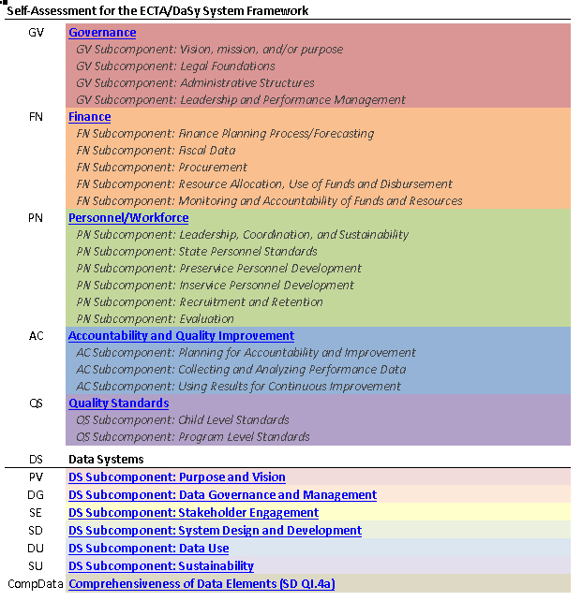
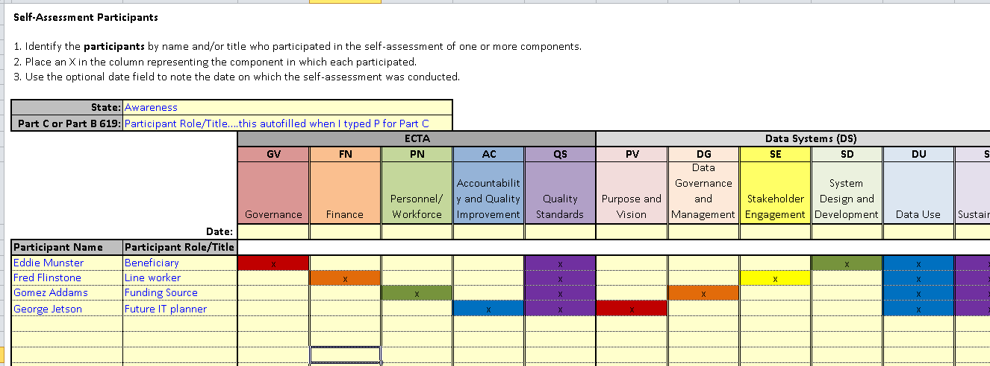
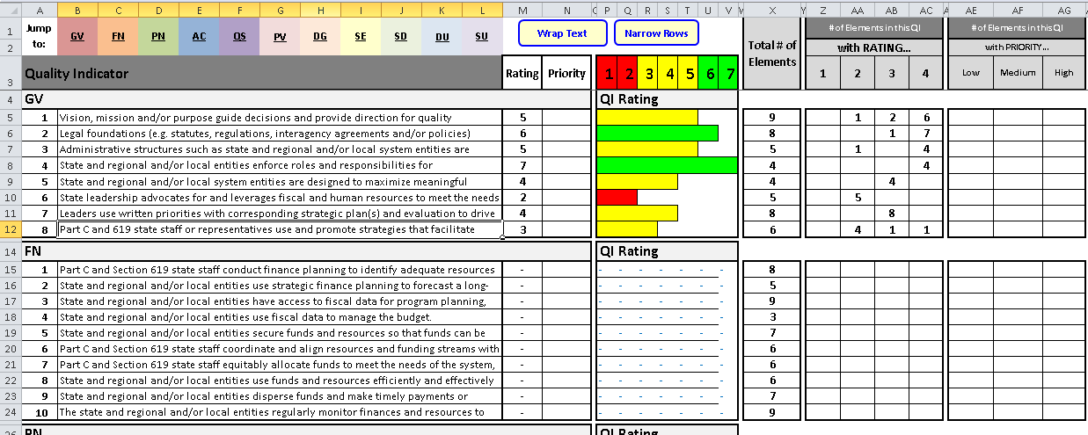
ECTA / DaSy Self Assessment

Slide 8
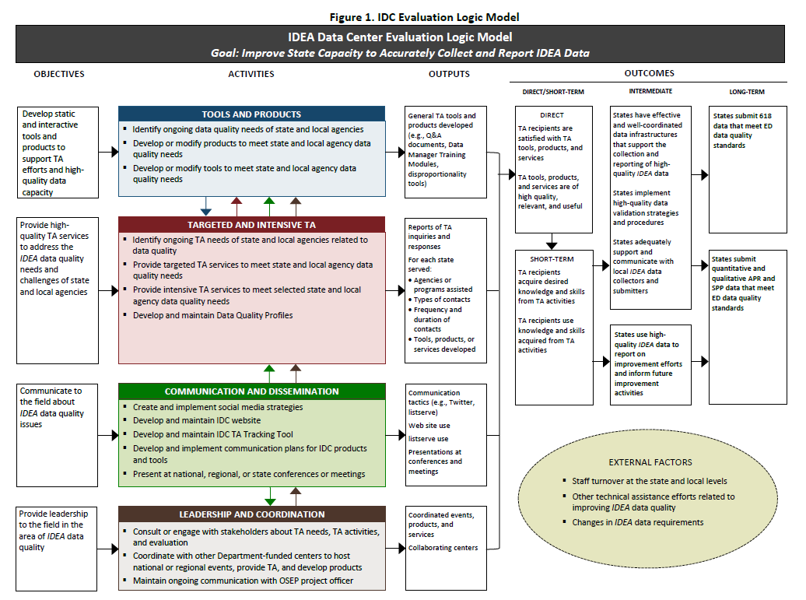
Logic Models

Slide 9
Next Steps
Implementation Teams identify more stakeholders (more families and providers)
Gap analysis in November
December 1 – All day meeting AT….
Logic Models and Evaluation
Report to OSEP
Team drafts to Alice by February 1 (seriously)
Final draft to Birth23.org by March 1
Final sections Submitted by April 1

Slide 10
THANK YOU!

